Slide 1
Roodson Francois

Slide 2
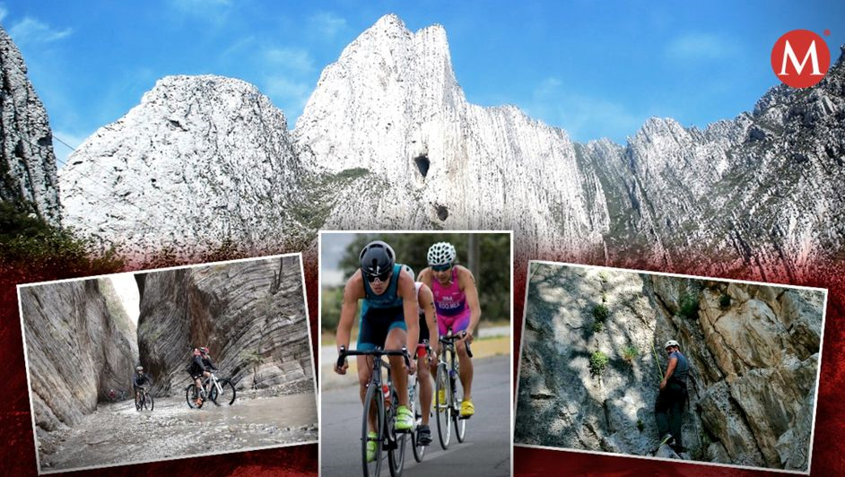
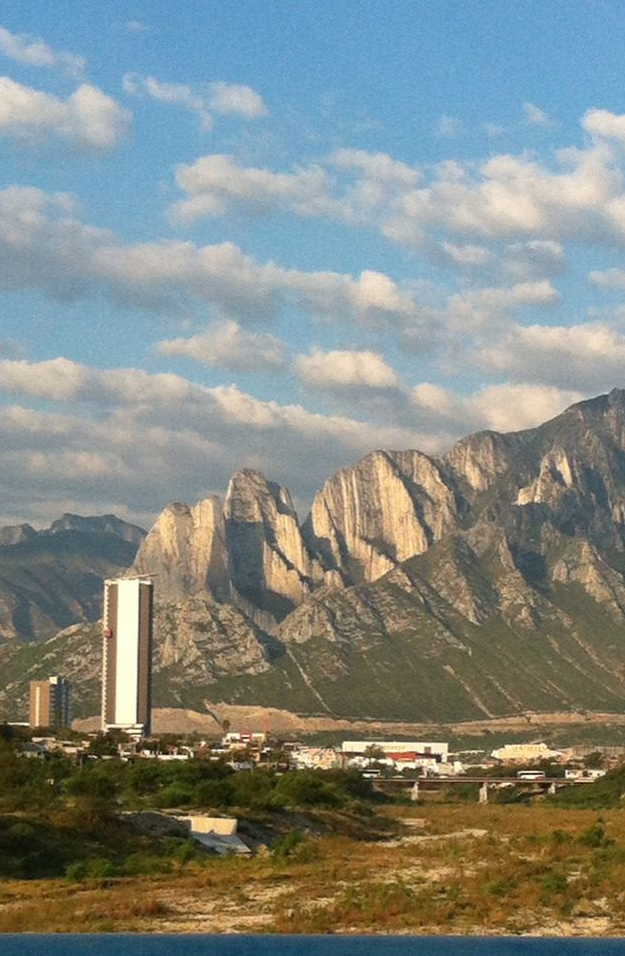
La Huasteca Monterrey
México

Slide 3

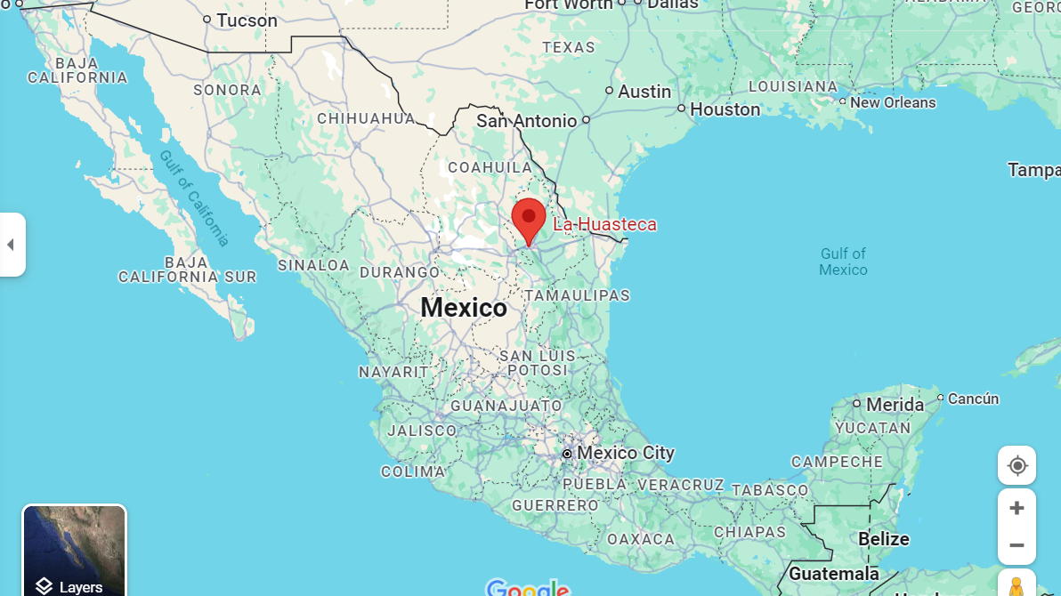



Parque La Huasteca is a municipal park in Monterrey, Mexico and also the first established climbing area

Slide 4

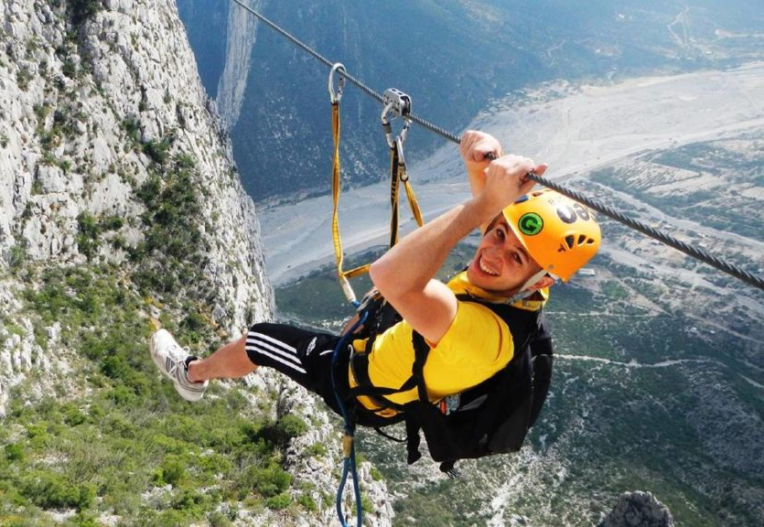
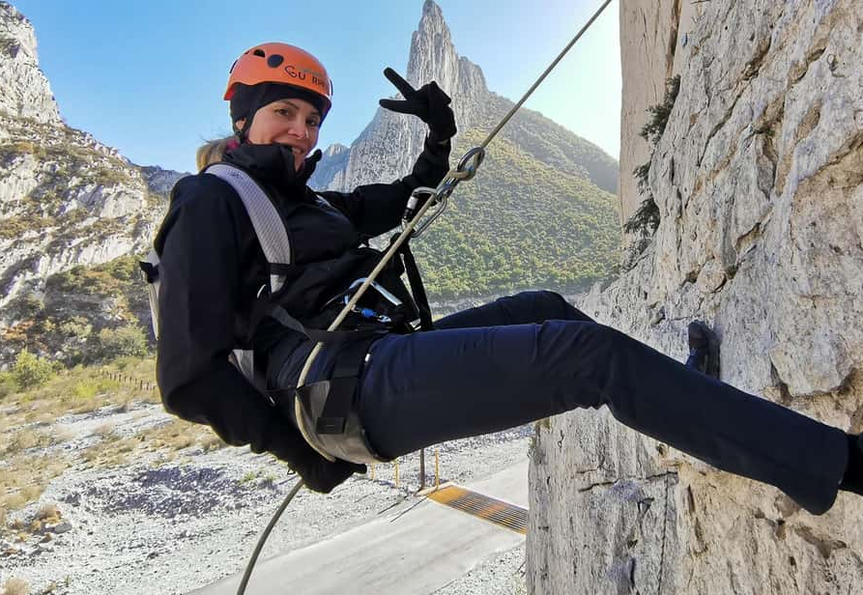
Spectacular limestone cliffs
Hiking
Climbing
Camping

Slide 5
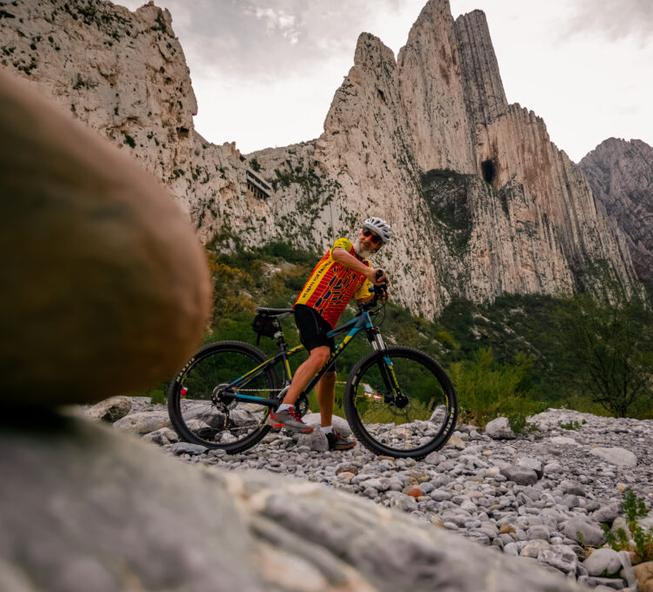
Best place to ride a mountain bike

Slide 6


